Slide 1
Docker architect

Slide 2
overview
azalea
petunia
/sqlite3
mqtt
hyacinth
redis

Slide 3
Image name
name | Image name | Container name | comment
hyacinth | yiyang2009/hyacinth:1.1.0 | hyacinth
mqtt |  |  | https://hub.docker.com/_/eclipse-mosquitto
redis |  |  | https://hub.docker.com/_/redis
petunia | yiyang2009/petunia:1.1.0 | petunia
azalea | yiyang2009/azalea | azalea

Slide 4
Docker file
https://github.com/haixiang1977/iris

Slide 5
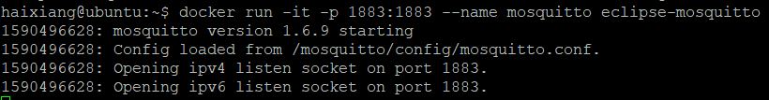
MOSQUITTO
docker run -it -p 1883:1883 --name mosquitto eclipse-mosquito
Next time, docker start container_id

Slide 6
hyacinth
Directory organization
Boost
boost_1_73_0/
install
Mosquito
mosquitto-1.4.11/
Install
hyacinth

Slide 7
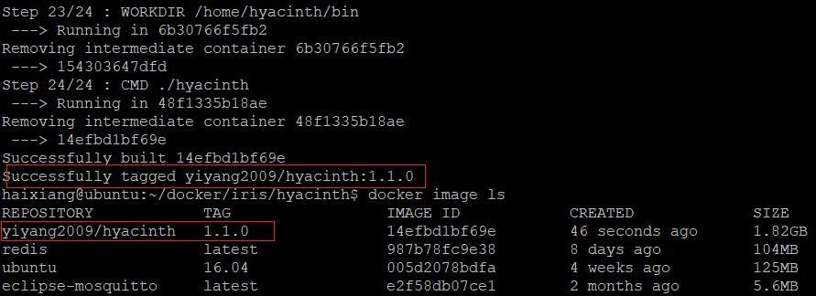
Hyacinth (cont.)
Git clone git@github.com:haixiang1977/iris.git
Git clone git@github.com:haixiang1977/hyacinth.git
docker build -t "yiyang2009/hyacinth:1.1.0" .

Slide 8
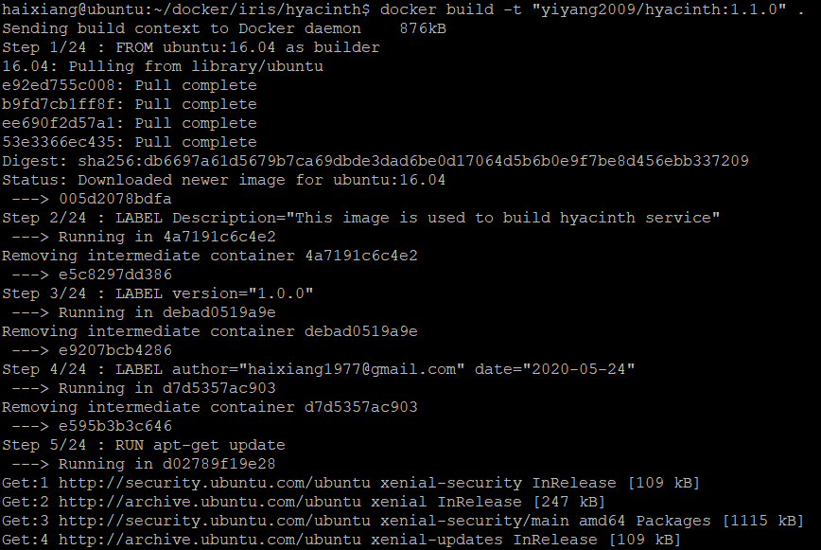
Hyacinth (cont.)

Slide 9
Hyacinth (cont.)
Run image and link to mosquito container
docker run --name hyacinth --link mosquitto yiyang2009/hyacinth:1.1.0

Slide 10
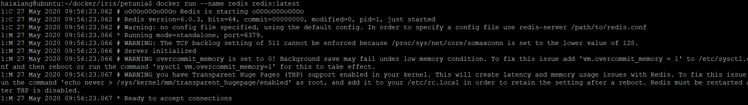
redis
docker run --name redis redis:latest

Slide 11
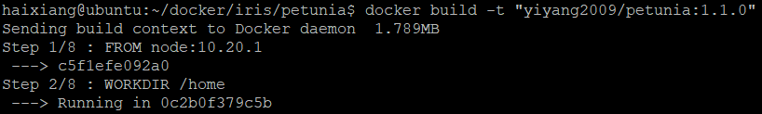
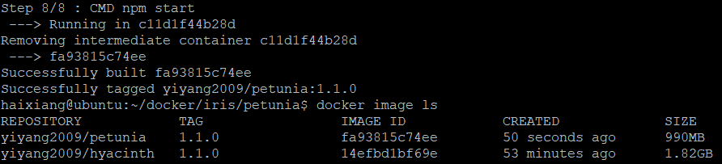
Petunia
Git clone git@github.com:haixiang1977/iris.git
Git clone git@github.com:haixiang1977/petunia.git
docker build -t "yiyang2009/petunia:1.1.0"

Slide 12
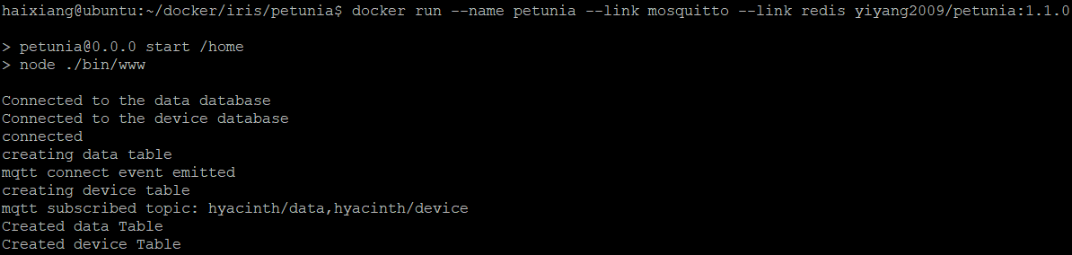
Petunia (cont.)
Run image and link to mosquito and redis container
docker run --name petunia --link mosquitto --link redis yiyang2009/petunia:1.1.0
With –d can detach

Slide 13
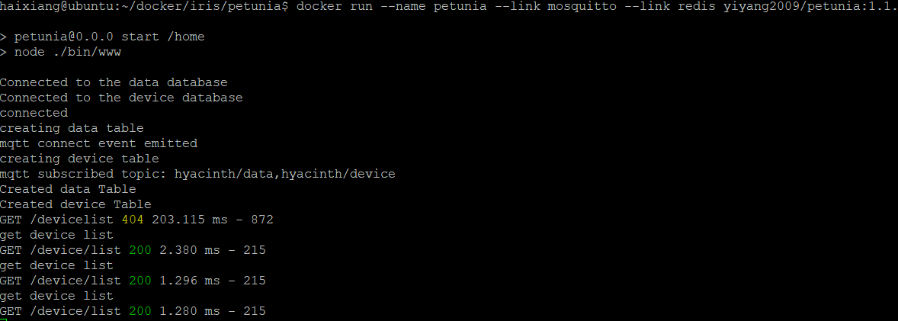
Petunia (cont.)

Slide 14
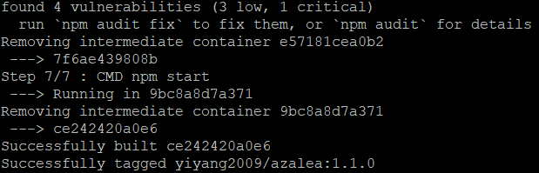
AZALEA
Git clone git@github.com:haixiang1977/azalea.git
docker build -t "yiyang2009/azalea:1.1.0" .

Slide 15
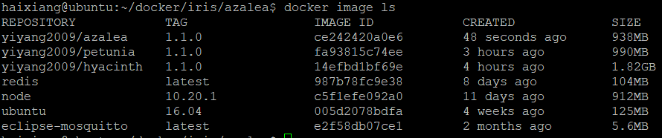
AZALEA (cont.)

Slide 16
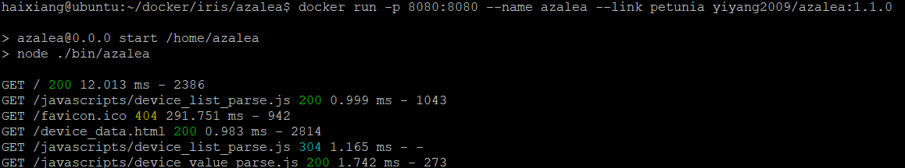
AZALEA (cont.)
Run image and link to petunia container and export 8080 to host
docker run -p 8080:8080 --name azalea --link petunia yiyang2009/azalea:1.1.0

Slide 17
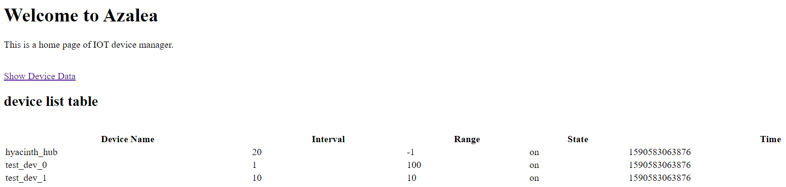
AZALEA (cont.)
127.0.0.1:8080

Slide 18

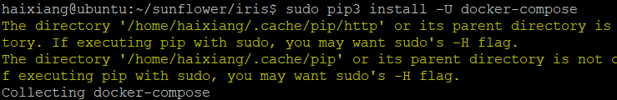
Docker compose
Install docker compose
sudo apt-get install python3-pip
sudo apt-get install python-pip
sudo pip3 install -U docker-compose

Slide 19
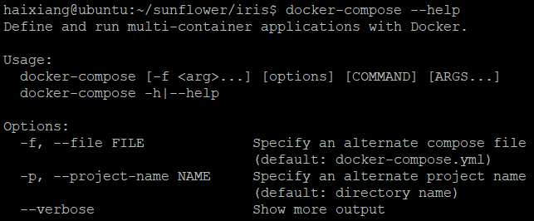
Docker compose (cont.)
Install docker compose (cont.)

Slide 20
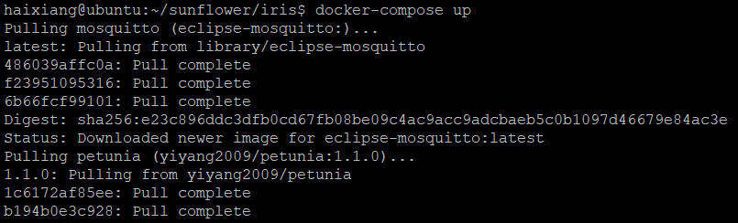
Docker compose (cont.)
Run docker-compose up

Slide 21
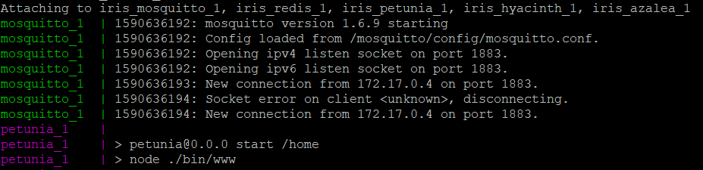
Docker compose (cont.)

Slide 22
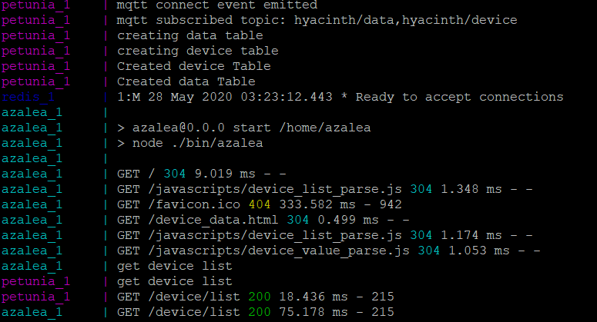
Docker compose (cont.)

Slide 23
END

